Slide 2
Minor Project – I Comparison between different compression algorithm
MEMBER’S NAME | ROLL NUMBER | SAP ID | BRANCH
Vinay Yadav | R103218167 | 500068489 | BAO
Tushar goyal | R103218163 | 500067581 | BAO
Sourabh Verma | R103218156 | 500069030 | BAO
Shivam Sahu | R103218140 | 500069419 | BAO
Under the guidance of
Astt. Professor
Mr. Shashi Bhushan

Slide 3
CONTENTS
Abstract
Introduction
Motivation
Literature Review
Problem Statement
Objective
Methodology
Flow Chart, Algorithm & Implementation
Progress (results if any)
References

Slide 4
Abstract
Data compression is a common requirement for most of the computerised applications. There are number of data compression algorithms, which are dedicated to compress different data formats. Even for a single data type there are number of different compression algorithms, which use different approaches. This project examines lossless data compression algorithms and compares their performance. A set of selected algorithms are examined and implemented to evaluate the performance in compressing text data. An experimental comparison of a number of different lossless data compression algorithms is presented in this project. The article is concluded by stating which algorithm performs well for text data.

Slide 5
Introduction
Compression is the art of representing the information in a compact form rather than its original or uncompressed form. In other words, using the data compression, the size of a particular file can be reduced. This is very useful when processing, storing or transferring a huge file, which needs lots of resources. If the algorithms used to encrypt works properly, there should be a significant difference between the original file and the compressed file.
Various lossless data compression algorithms have been proposed and used.
Lossless compression techniques are used to compress medical images, text and images preserved for legal reasons, computer executable file and so on.

Slide 6
Lossy compression techniques reconstruct the original message with loss of some information. It is not possible to reconstruct the original message using the decoding process, and is called irreversible compression. Some of the main techniques in use are the Huffman Coding, Run Length Encoding,Shannon Fano Algorithm In particular, performance of these algorithms in compressing text data is evaluated and compared.

Slide 7
Motivation
Recent advancements in the field of information technology resulted in the generation of a huge amount of data every second. As a result, the storage and transmission of data are likely to increase at an enormous rate. So we want to compare different techniques of data compression to find out that which techniques works best in given conditions.

Slide 8
Literature Review
The problem of data compression is one of the important aspects in the development of information technology. Data compression is a process of resizing a file or document to be smaller in size. Along with the development of hardware and software technology is increasingly sophisticated and complex that demands the efficiency in terms of data storage and memory[1].
Communication is the exchange of thoughts, messages, or information, as by speech, visuals, signals, writing or behaviour. When two entities are communicating and do not want a third party to listen in or know, they need to communicate in such a way that it doesn’t get intercepted. Secure communication is needed and there exists many tools for this. With secure communication, if we

Slide 9
Literature Review
use compressed form of the messages which are being sent, this will make an effective and powerful system. Compressed message will be smaller in size than the original and less bits will be needed to make it confidential[2].
This is very useful when processing, storing or transferring a huge file, which needs lots of resources. If the algorithms used to encrypt works properly, there should be a significant difference between the original file and the compressed file. When data compression is used in a data transmission application, speed is the primary goal. Speed of transmission depends upon the number of bits sent, the time required for the encoder to generate the coded message and the time required for the decoder to recover the original ensemble. In a data storage application, the

Slide 10
Literature Review
degree of compression is the primary concern. Compression can be classified as either lossy or lossless. Lossless compression techniques reconstruct the original data from the compressed file without any loss of data. Thus the information does not change during the compression and decompression processes[3].
We require the ability to reconstitute the original file from the compressed version at any time. Data compression is a method of encoding rules that allows substantial reduction in the total number of bits to store or transmit a file. The more information being dealt with, the more it costs in terms of storage and transmission costs[4].
We check the performance of these three lossless data compression algorithms for compressing text data and then the compressed text data will be evaluated and compared.

Slide 11
Problem Statement
1) Data compression systems include as an integral part a certain classifier that allows you to select the most efficient compression algorithm.
2) A compression problem from the algorithmic point of view is to find an effective and efficient algorithm to remove various redundancy from certain types of data by using lossless data compression algorithm.
3) It is used to examines the performance of the Run Length Encoding Algorithm, Huffman Encoding Algorithm, Shannon Fano Algorithm.
4) In order to examine the performance of these algorithms in compressing text data is evaluated and compared.

Slide 12
Objective
The main objective of this project is to find out that which techniques works best in given conditions by comparing different data compression technique. We compare different techniques on the basis of Compression Time , compression ratio, compression factor.
o compare & evaluate the performance of the algorithms.
To implement and compare the compressed file sizes using Huffman Encoding, Run Length Encoding, and Shannon Fano Algorithm.
To reduce the amount of redundant information in the stored or communicated data.
To compress the text data and also allows the original data to be reconstructed from the compressed data.

Slide 13
Methodology
In order to test the performance of lossless compression algorithms, the Run Length Encoding Algorithm, Huffman Encoding Algorithm, Shannon Fano Algorithm are implemented and tested with a set of text files. Performances are evaluated by computing the above mentioned factors.
Measuring the Performance of RLE Algorithm Since the Run Length Encoding Algorithm does not use any statistical method for the compression process, the Compression and Decompression times, File Sizes, Compression Ratio and Saving Percentage are calculated. Several files with different file sizes and text patterns are used for computation.
Measuring the Performance of Static Huffman Approaches Static Huffman Encoding and Shannon Fano approaches are implemented and executed independently. For these two approaches, file sizes, compression and decompression times, entropy and code efficiency are calculated.

Slide 14
Measuring the Performance of Adaptive Huffman Encoding Adaptive Huffman Encoding is also implemented in order to compare with other compression and decompression algorithms. A dynamic code word is used by this algorithm. File sizes, compression and decompression times, entropy and code efficiency are calculated for Adaptive Huffman Algorithm.

Slide 15
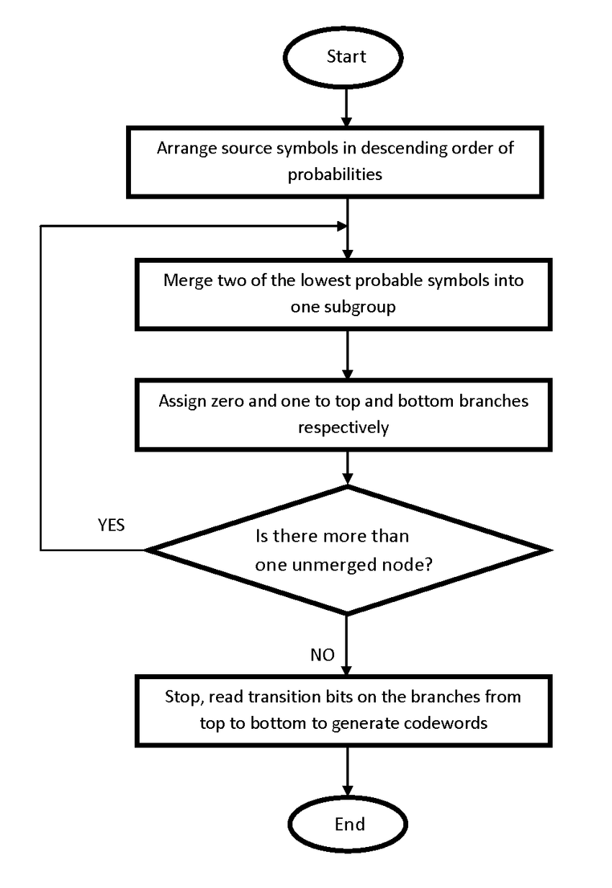
Flow Chart

Slide 16
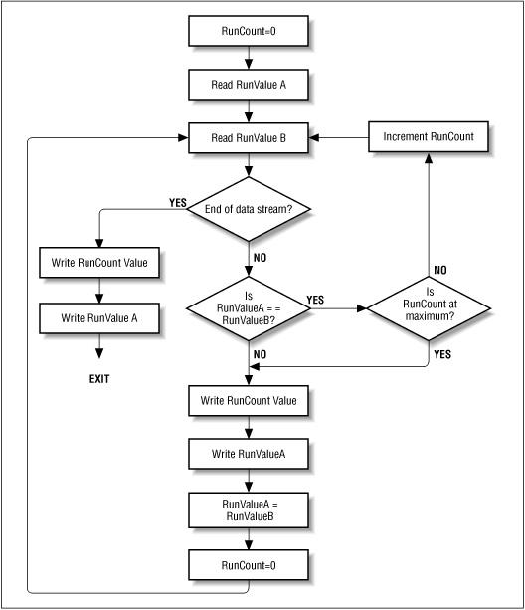
Run Length Encoding Flowchart

Slide 17
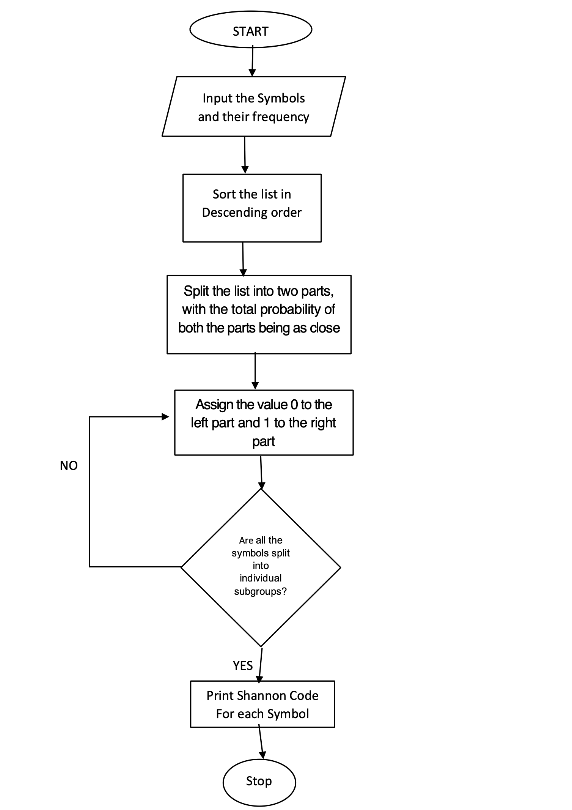
Shannon-Fano Encoding

Slide 18
Algorithms
Algorithm for Huffman Encoding
Step1: Compute the probability of each character.
Step2: Sort the set of data in ASCENDING order.
Step3: Create a new node where the left child is the lowest in the sorted list and the right is the second lowest in the sorted list.
Step4: Chop-off those elements in the sorted list as they are now part of one node and add the probabilities. The result is the probabilities for the new node.
Step5: Perform insertion sort on the list with the new node. Step6: Repeat steps 3, 4, 5 until, only have one node left.

Slide 19
Algorithms
Algorithm for Run Length Encoding
step1: Pick the character from source string.
step2: Append the picked character to the destination string.
step3: Count the number of subsequent occurrences of the picked character and append the count to destination string.
step4: Pick the next character and repeat steps 2, 3 and 4 if end of string is NOT reached.

Slide 20
Algorithms
Algorithm for Shannon-Fano Encoding
Step1: Create table providing frequencies / counts.
Step2: sort symbols according to their frequencies/ Probabilities in descending order.
Step3: Recursively divided into two parts, each with approx (binary) same number of counts.
Step4: Add a binary 0 to the code words of the upper part and a binary 1 to the lower part.
Step5: Search for the next part containing more than two symbols, repeat the step3 and step4.
Step6: Coding of the origination data according to code words.
Step7: Create the coding tree
Step8: Transmit Codes instead of Tokens.

Slide 21
Implementation
Pseudocode (Huffman):
1. Find frequencies of all the characters in the string
2. Make a node corresponding to every (character,frequency)
3. Heapify the nodes
4. While heap has 2 or more nodes
5. Pop 2 nodes say first and second
6. Make a new node x, with frequency = first.freq + second.freq
7. Make first node as left child of x
8. Make second node as right child of x
9. Insert x into the heap
10. Extract the last node which is the root of the tree
/*For assigning codes to each charater,*/

Slide 22
Implementation
11. Traverse the tree
12. If you move left, assign the path 0
13. If you move right, assign the path 1
14. If you reach the leaf node:
/* Code for the character of the leaf node is the path from the root to that node.*/
Pseudocode (Run Length):
Loop: count = 0

Slide 23
Implementation
REPEAT
get next symbol
count = count + 1
UNTIL (symbol unequal to next one)

Slide 24
Implementation
output symbol
IF count > 1
output count
GOTO Loop

Slide 25
Implementation
Pseudocode (Shannon-Fano):
1. Find the probability of occurrence of each character in the string
2. Sort the array of characters in the increasing order of their probabilities, say A
3. fanoShannon(A)
4. If (size(A)==1)
5. return

Slide 26
Implementation
6. Divide A into left and right such that the difference between the sum of probabilities of left half and right half is minimum
7. Append 0 in the codes of the left half
8. Append 1 in the codes of the right half
9. fanoShannon(left)
10. fanoShannon(right)

Slide 27
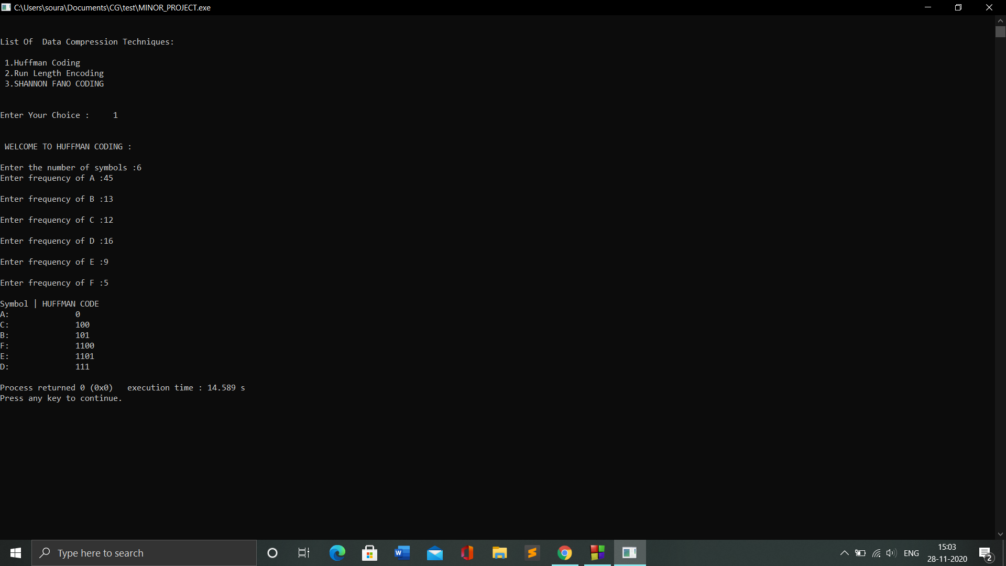
Implementation
Output For Huffman Coding

Slide 28
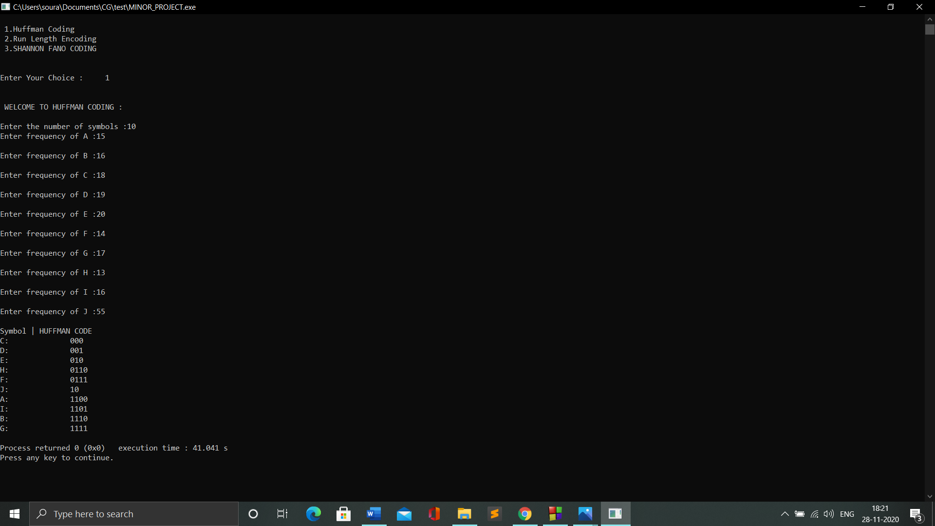
Implementation

Slide 29
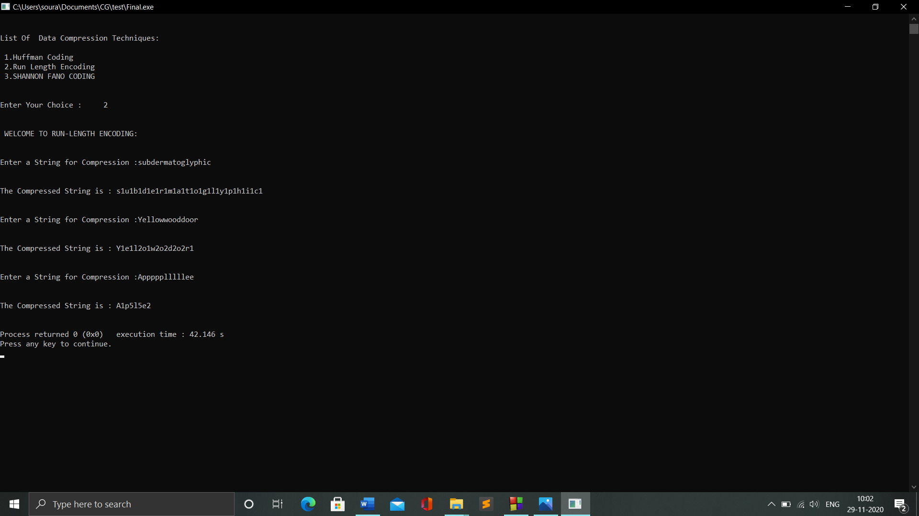
Implementation
Output For Run Length Encoding:

Slide 30
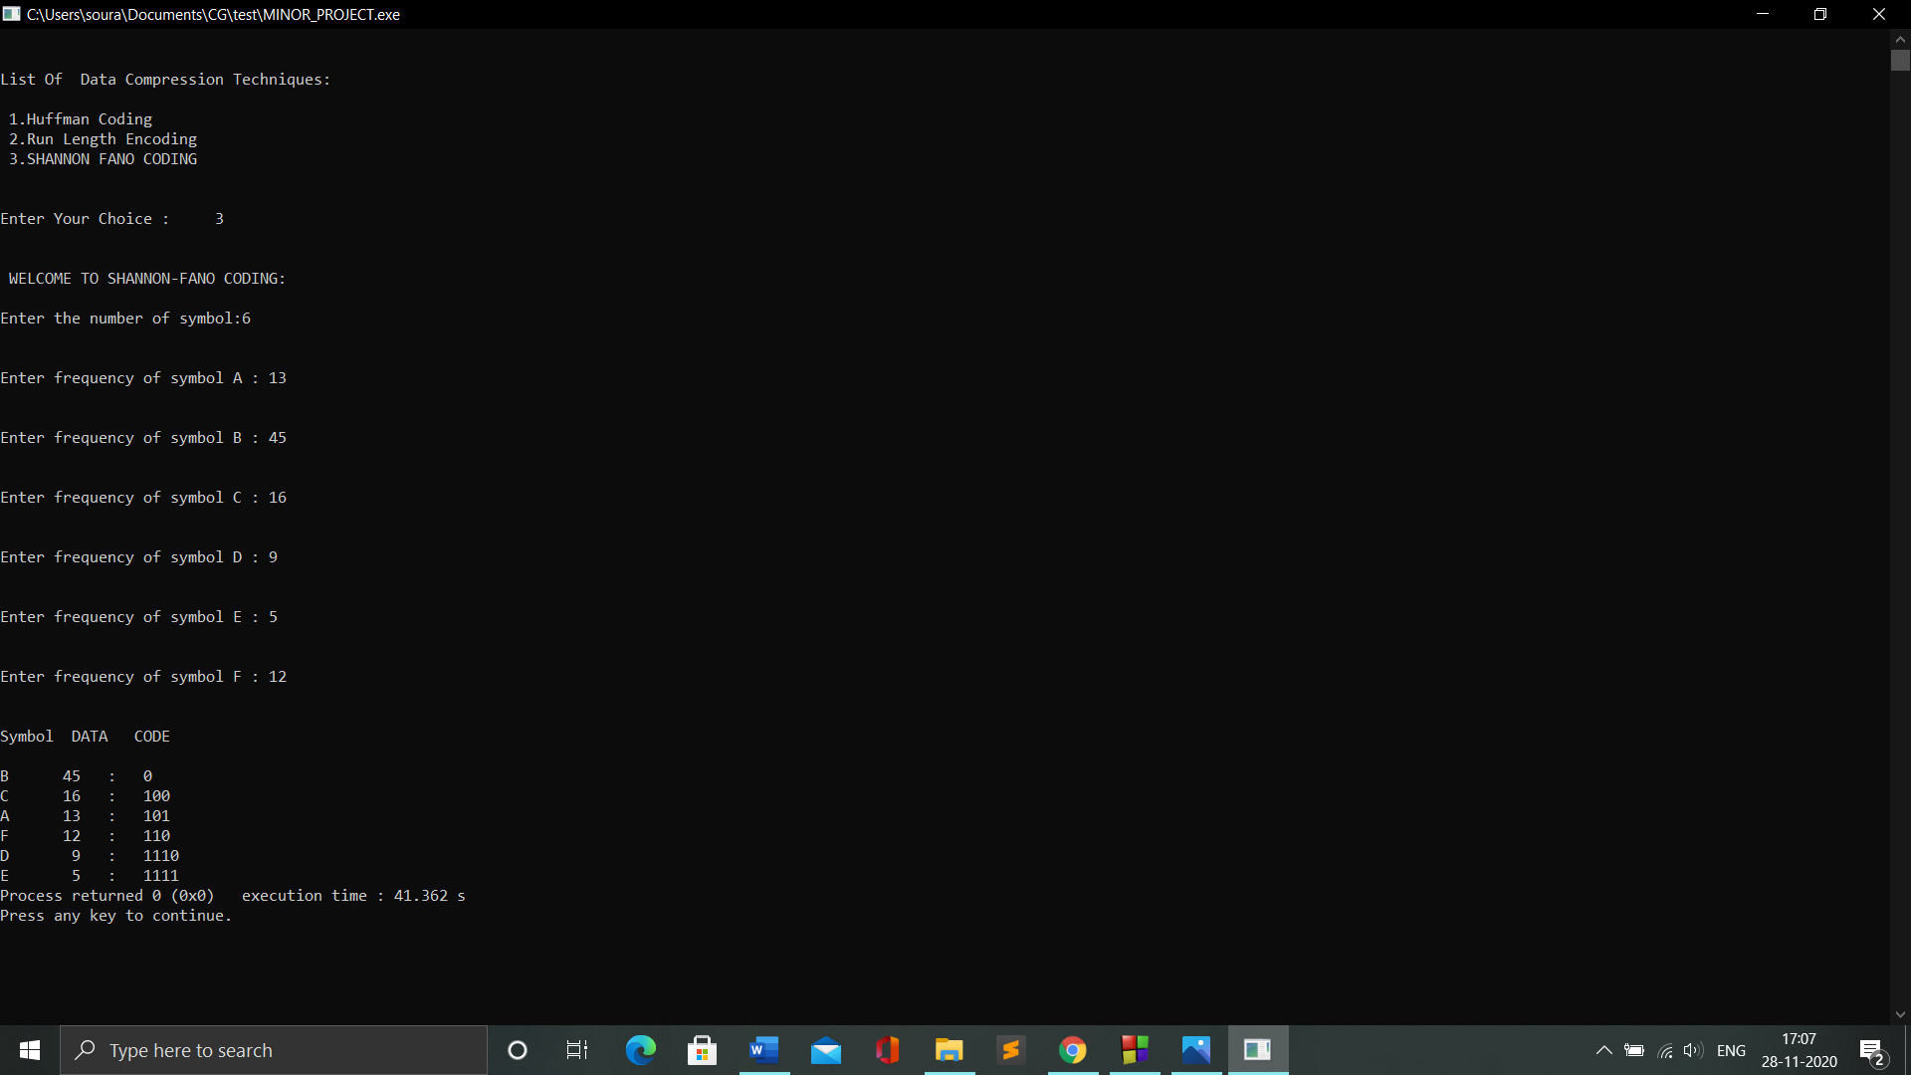
Implementation
Output For Shannon-Fano:

Slide 31
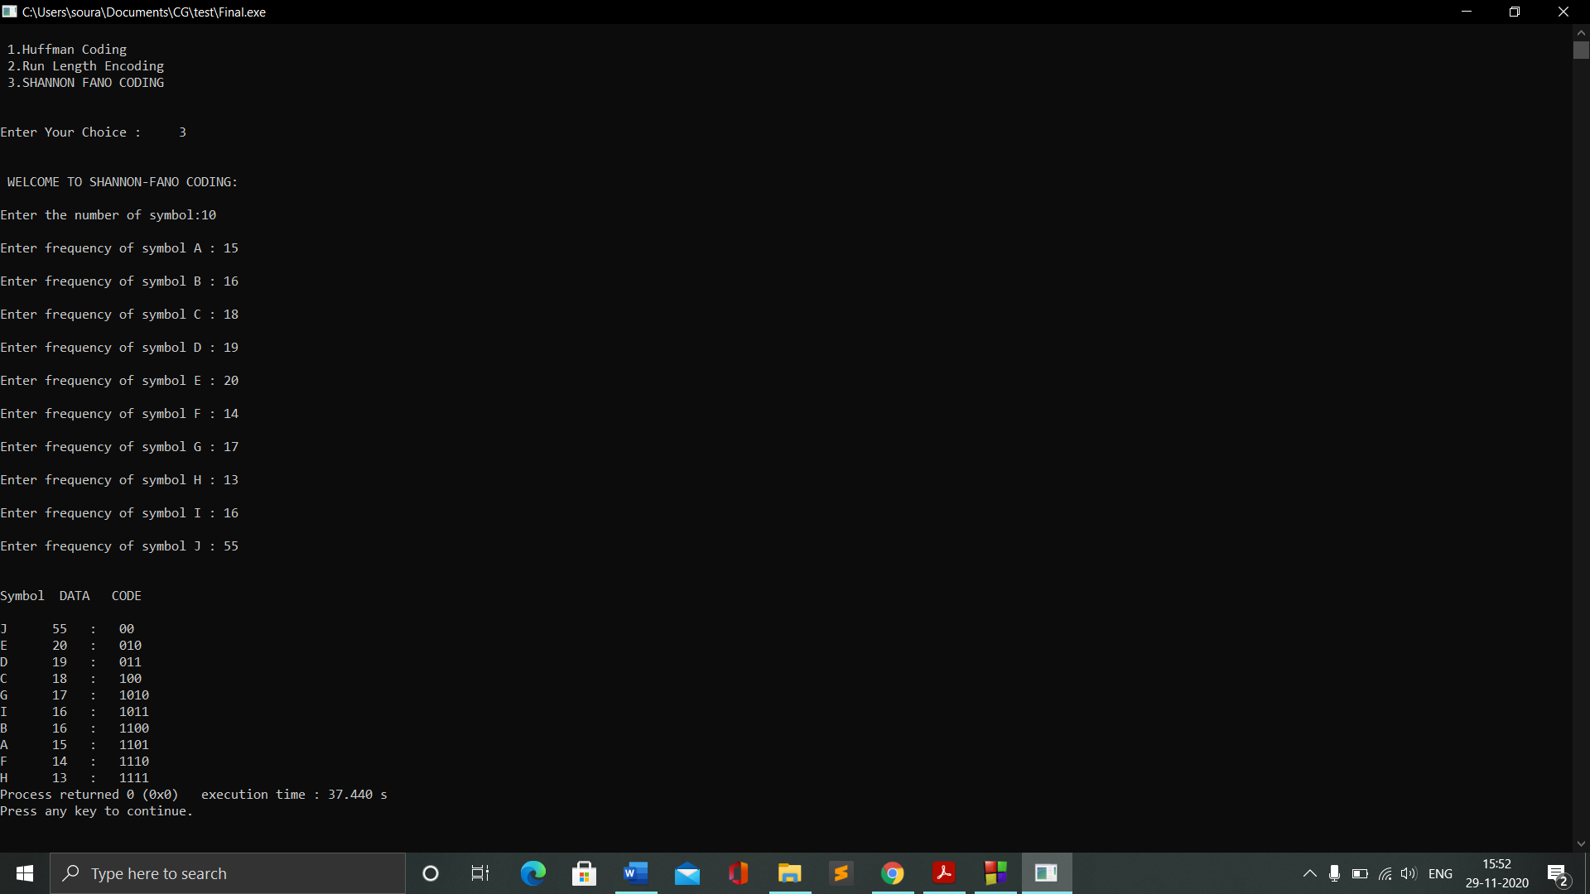
Implementation

Slide 32
Results Comparison on the basis of file size

Slide 33
(Compression Ratio)

Slide 34
References
[1] Dea Ayu Rachesti, Tito Waluyo Purboyo, and Anggunmeka Luhur Prasasti, “of Text Data Compression Using Huffman, Shannon-Fano, Run Length Encoding, and Tunstall Methods” ,available at http://www.ripublication.com. International Journal of Applied Engineering Research ISSN 0973-4562 Volume 12, Number 23 (2017) pp. 13618-13622.
[2] Nigam Sangwan, ” Text Encryption with Huffman Compression”, International Journal of Computer Applications (0975 – 8887) Volume 54– No.6, September 2012, Institute of Technology and Management University, Gurgaon, Haryana, India.
[3] S.R. kodituwakku, & U. S.Amarasinghe , ” Comparison of lossless data compression algorithms for text data”, Indian Journal of Computer Science and Engineering Vol 1 No 4 416-426.
[4] Amandeep Singh Sidhu, & Er. Meenakshi Garg, “Research Paper on Text Data Compression Algorithm using Hybrid Approach”, International Journal of Computer Science and Mobile Computing, Vol.3 Issue.12, December- 2014, pg. 01-10.

Slide 35
References
[5] T.SubhamastanRao , M.Soujanya, T.Hemalatha, &T.Revathi, ” Simultaneous Data Compression and Encryption”, ) International Journal of Computer Science and Information Technologies, Vol. 2 (5) , 2011, 2369-2374.
[6] Tito Waluyo Purboyo, & Anggunmeka Luhur Prasasti, “ Comparison of Data Compression in Text Using Huffman, Shannon-Fano, Run Length Encoding, and Tunstall Method” , International Journal of Applied Engineering Research · January 2017.
[7] P.Yellamma, and Dr.Narasimham Challa, “Performance Analysis Of Different Data Compression Techniques On Text File”, International Journal of Engineering Research & Technology (IJERT) Vol. 1 Issue 8, October – 2012.
[8] Shrusti Porwal, Yashi Chaudhary, Jitendra Joshi, Manish Jain, “Data Compression Methodologies for Lossless Data and Comparison between Algorithms”, International Journal of Engineering Science and Innovative Technology (IJESIT) Volume 2, Issue 2, March 2013.

